Slide 1


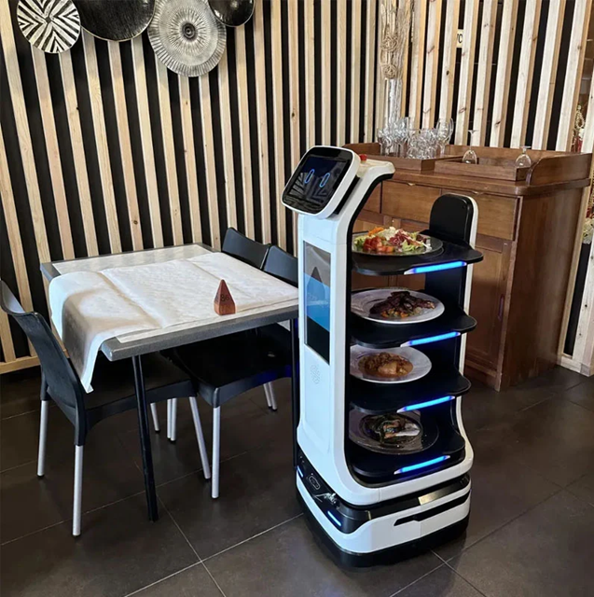
Embedded Systems
Restaurant Delivery Robot
Group 3:
Bùi Trịnh Thế Viên
Trần Đăng Bách
Nguyễn Văn Quý
Nguyễn Trọng Nhân

Slide 2
Table of Contents:
Introduction (overview + objectives)
System Architecture & Flowchart Diagrams
Use Case Diagram
Timeline
Project Task Allocation (tasks + contribution percentage)

Slide 3
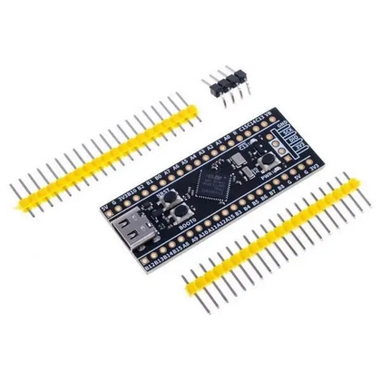
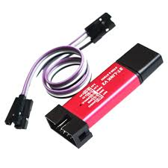
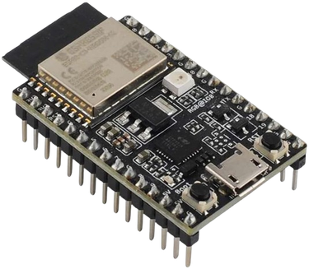
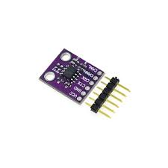
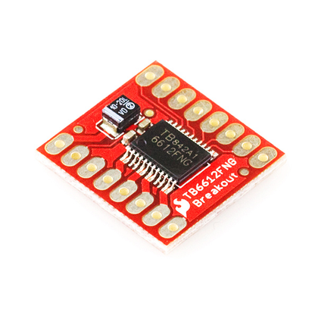
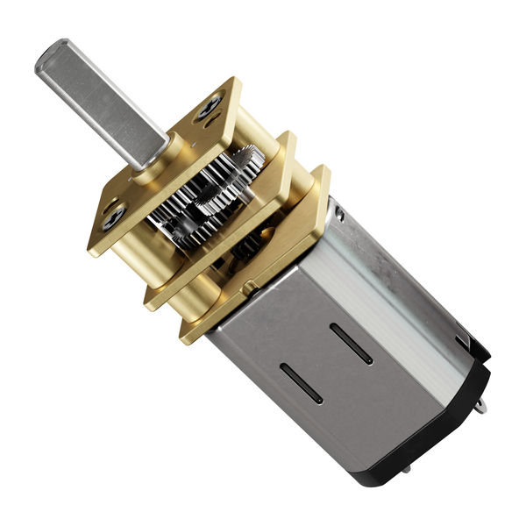
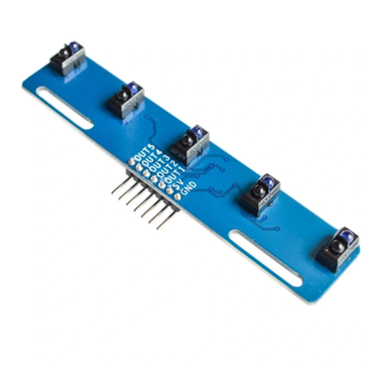
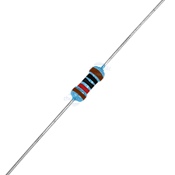
COMPONENTS
ESP32-C3
STM32H5
STLINK-V2
MCP2551
Resistor-120ohm
Driver motor
Motor N20
Line sensor

Slide 4
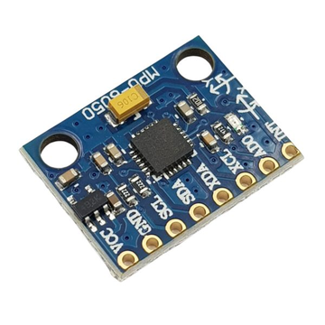
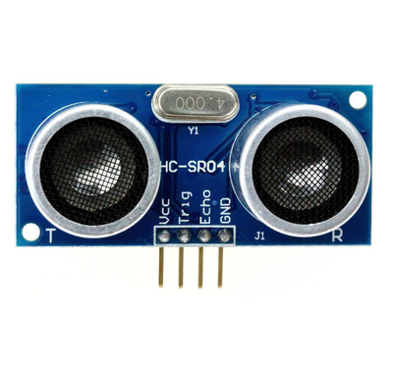
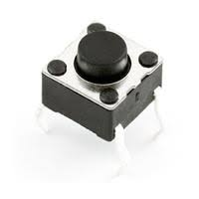
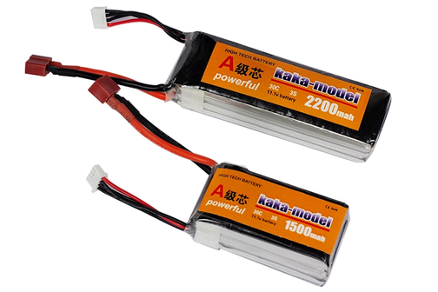
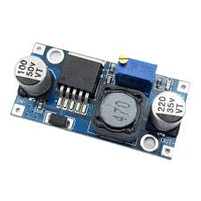
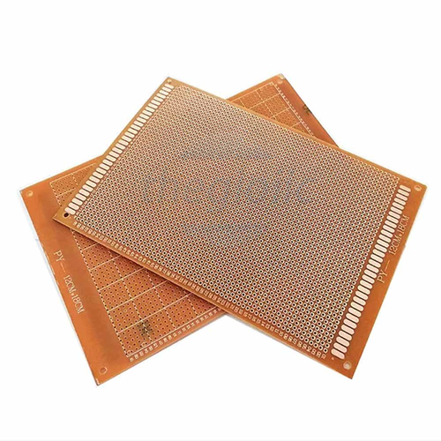
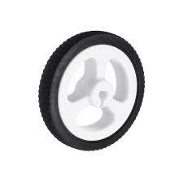
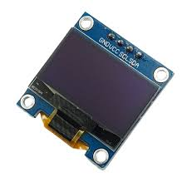
COMPONENTS
MPU6050
HC-SR04
BUTTON
Pin Li-ion
LM2596
PCB
Wheel
Oled(I2C)

Slide 5
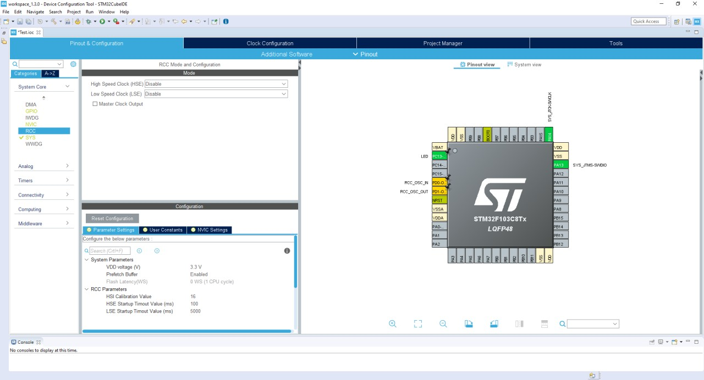
SOFTWARE & DEBUGGING TOOLS
Development IDEs
STM32CubeIDE
ESP-IDF
VS Code + Espressif Extension
Firmware Libraries
FreeRTOS
STM32 HAL
ESP-IDF TWAI driver
ESP-IDF WiFi + lwIP
MPU-6050/9250 driver
SSD1306 driver
Madgwick / Complementary Filter
Debugging & Analysis Tools
OpenOCD + GDB
Saleae Logic Analyzer
ESP-IDF Monitor
SEGGER SystemView

Slide 6
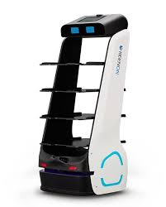
Introduction
Problem Statement:
In today's context, the restaurant service industry is gradually shifting toward automation in order to:
Reduce labor costs
Increase service efficiency
Enhance customer experience
However, existing restaurant robot systems still have several limitations:
Centralized processing → prone to overload, difficult to scale
Slow response in emergency situations
Lack of stability when operating in real-world environments
Therefore, there is a need to build a robot system that:
Is capable of distributed processing
Guarantees real-time performance
Operates safely and reliably

Slide 7
Introduction
This project focuses on designing an automated delivery robot using a Multi-MCU architecture combined with CAN Bus communication.
The system is divided into 3 main blocks:
MCU1 (ESP32): handles system logic, receives orders via WiFi, and coordinates the overall system
MCU2 (STM32H5): controls movement, positioning, and navigation
MCU3 (STM32H5): handles sensor processing and ensures safety
Each microcontroller operates independently and communicates with one another via CAN Bus, which helps to:
Increase system stability
Reduce processing load on each block
Allow easy system expansion
The system uses FreeRTOS to manage multitasking and ensure real-time operation.

Slide 8
Introduction
Objectives:
General Objective:
To build a restaurant delivery robot system capable of operating autonomously, stably, and safely in a real restaurant environment.
Specific Objectives:
Receive and process orders via WiFi connection
Navigate the robot to the desired destination
Detect and avoid obstacles in real time
Perform an emergency stop when a hazard occurs
Return to the base position after completing a delivery
Enable communication between MCUs via CAN Bus
Apply FreeRTOS for efficient multitasking management

Slide 9
1. System Architecture
System Architecture: 3 nodes on CAN Bus:
ESP32 (MCU1) — Brain / WiFi / Mission Controller / OLED Display
STM32H5 (MCU2) — Motion & Navigation Controller
STM32H5 (MCU3) — Perception & Safety Controller
Node | ID
ESP32 | 0x01
STM32H5 | 0x02
STM32H5 | 0x03

Slide 10
1. System Architecture
MCU3 (0x3xx) | MCU2 (0x2xx) | Type | MCU1 (0x1xx)
EMERGENCY_STOP → MCU2 | NAV_STATUS → MCU1 | 0x01 | NAV_CMD → MCU2
OBSTACLE_ALERT → MCU1 | ARRIVED → MCU1 | 0x02 | RETURN_BASE → MCU2
PATH_CLEAR → MCU1 | ODOMETRY → MCU1 | 0x03 | SOFT_STOP → MCU2
PERCEPTION_REPORT → MCU1 | BUMP_ALERT → MCU1 | 0x04 | PERCEPTION_ARM → MCU3
HEARTBEAT → MCU1 | HEARTBEAT → MCU1 | 0x05 | HEARTBEAT → ALL
Message ID Structure (11-bit):
Bits [10:8] = Sender Node ID
Bits [7:0] = Message Type
Node | ID
ESP32 | 0x01
STM32H5 | 0x02
STM32H5 | 0x03

Slide 11
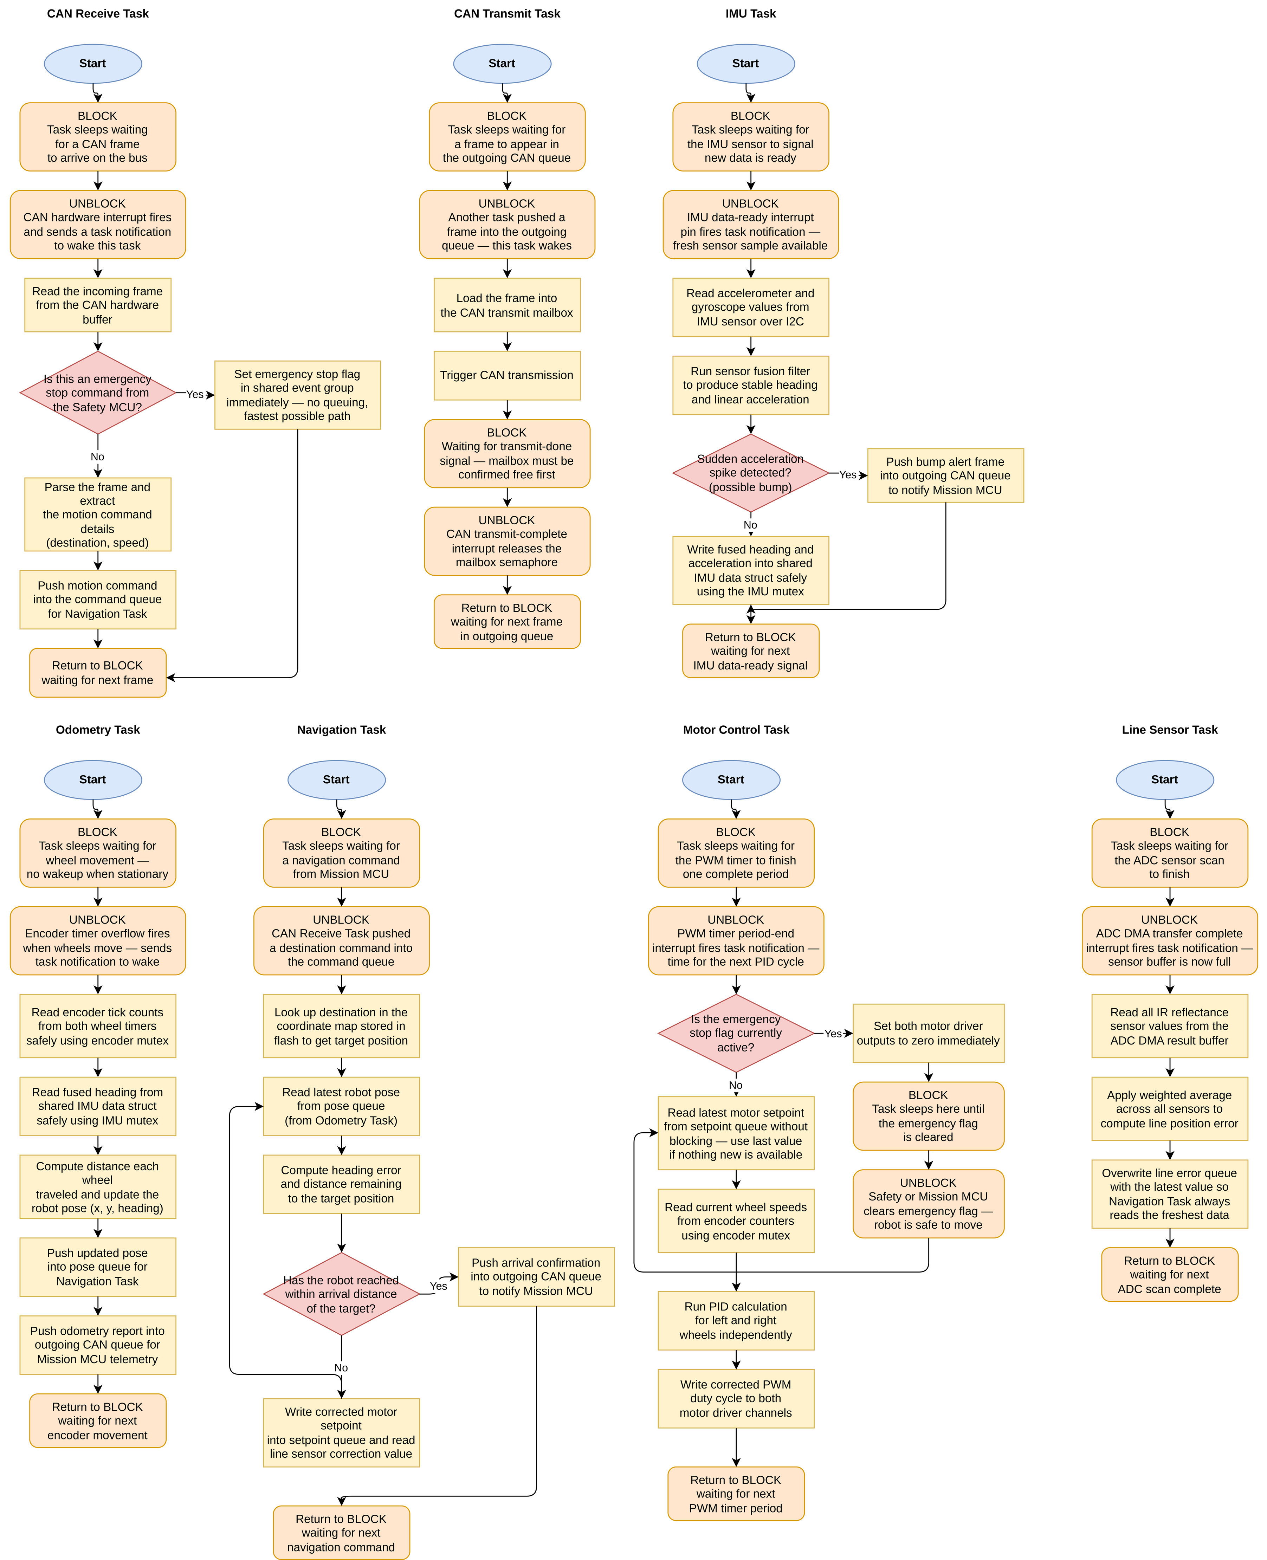
2. Flow chart

Slide 12
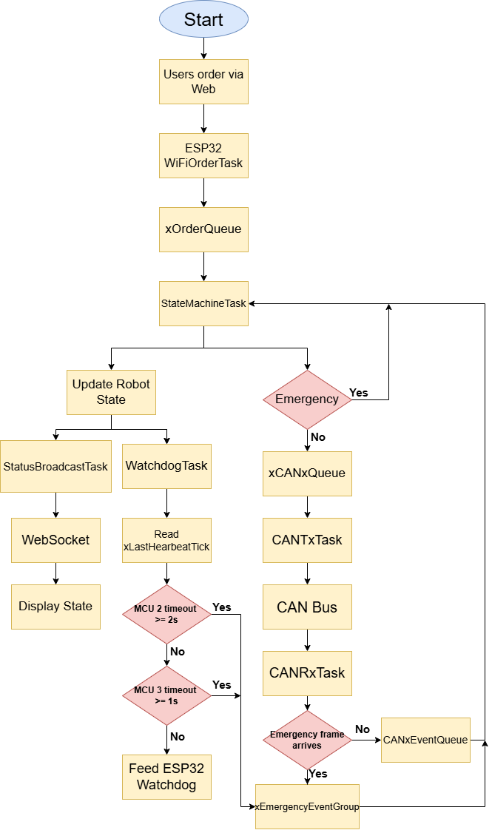
2. Flow chart
ESP32 (MCU1) — Brain, WiFi, Mission Controller, OLED Display

Slide 13
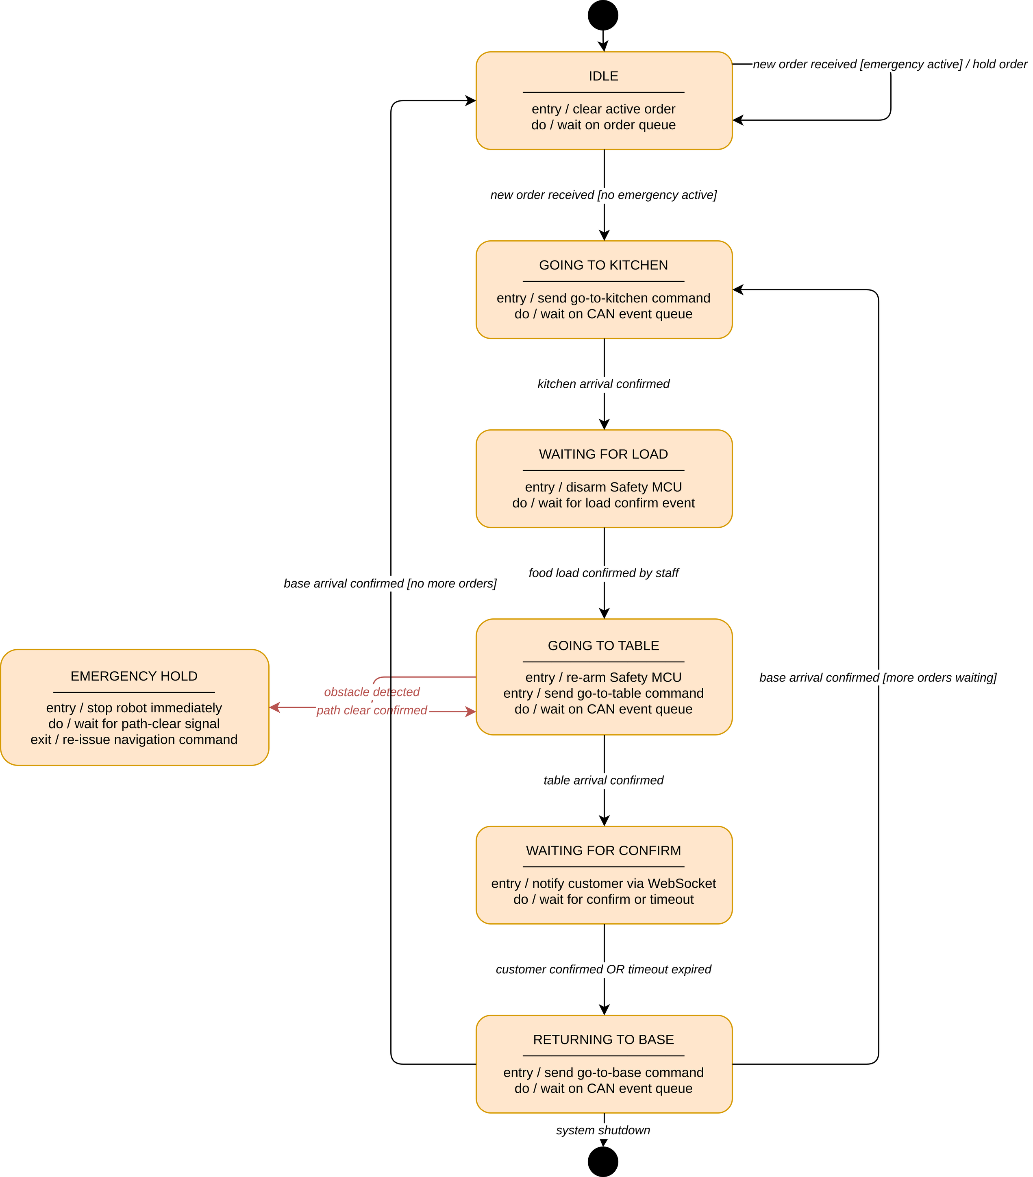
2. Flow chart
State machine task
ESP32 (MCU1) — Brain, WiFi, Mission Controller, OLED Display

Slide 14
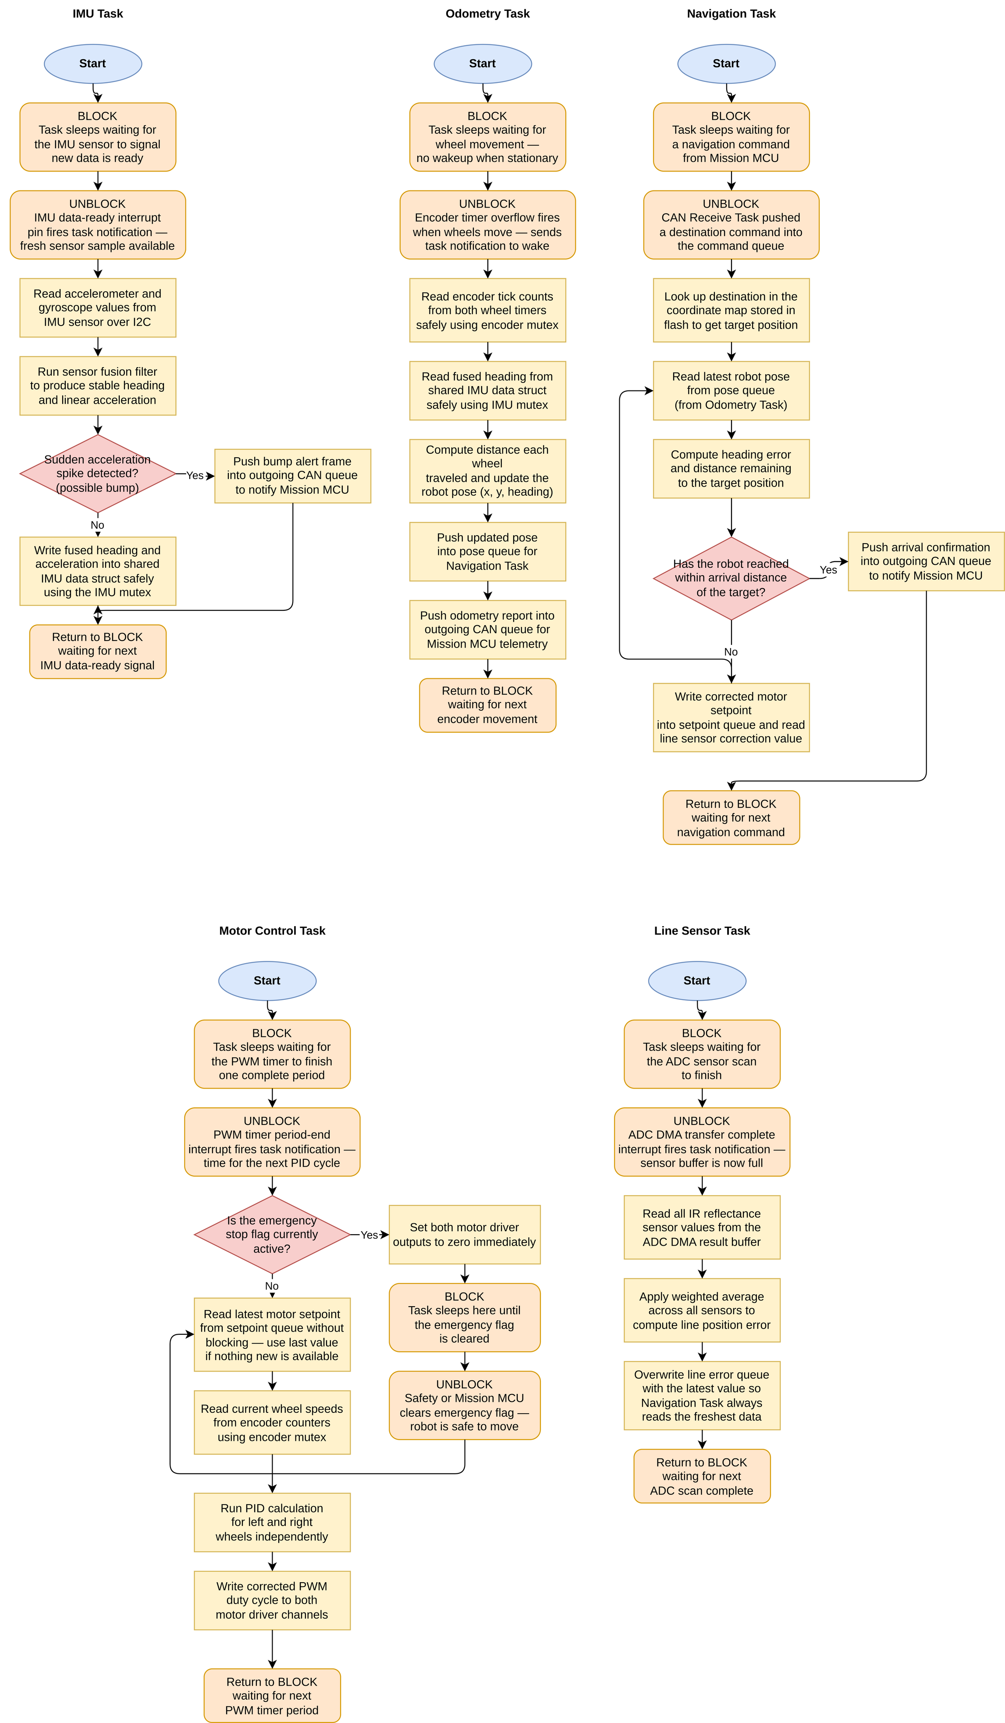
2. Flow chart
STM32H5 (MCU2) — Motion & Navigation Controller

Slide 15
2. Flow chart
STM32H5 (MCU2) — Motion & Navigation Controller

Slide 16
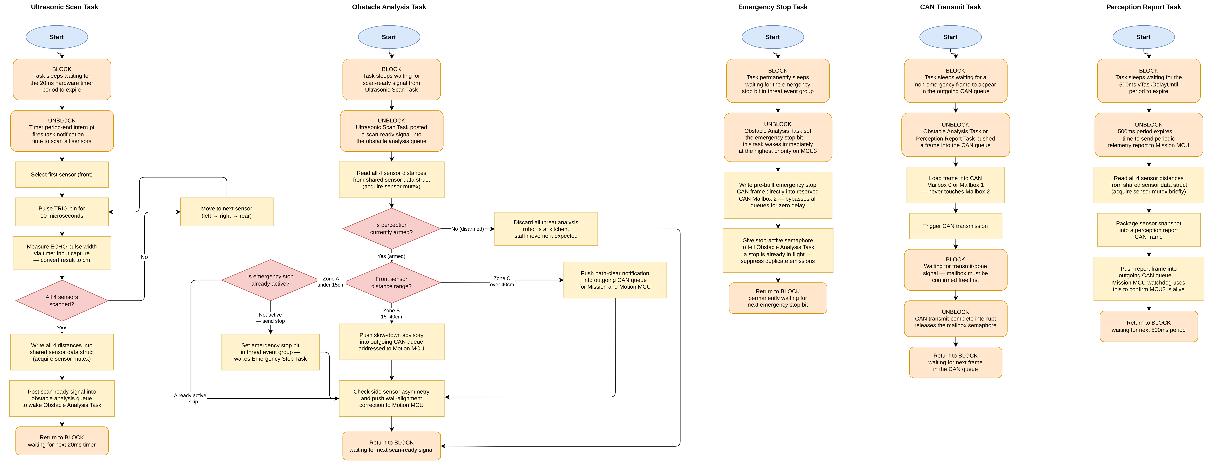
2. Flow chart
STM32H5 (MCU3) — Perception & Safety Controller

Slide 17
2. Flow chart
STM32H5 (MCU3) — Perception & Safety Controller

Slide 18
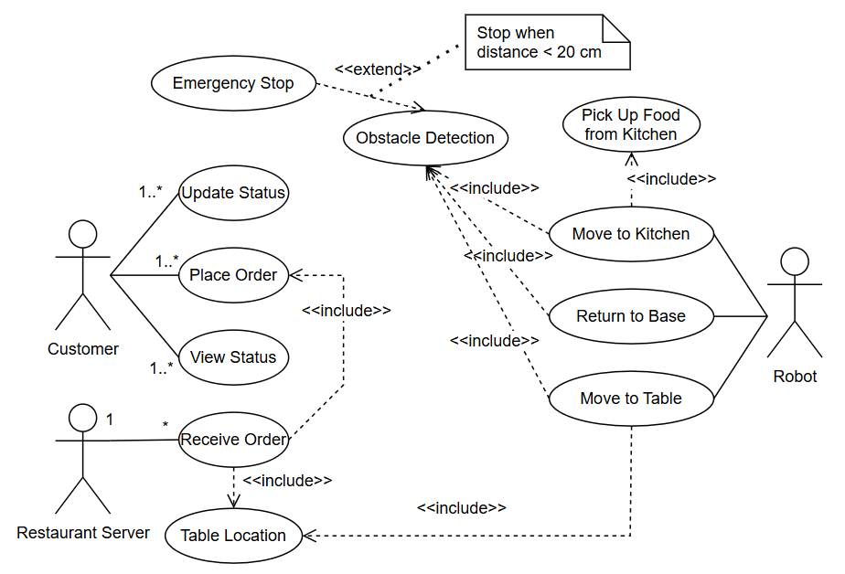
Use case diagram

Slide 19
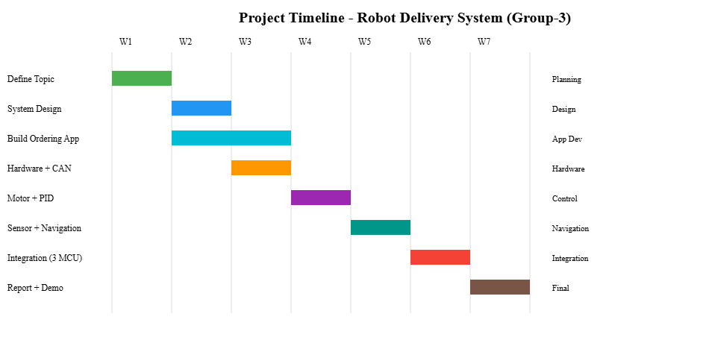
Timeline

Slide 20
Timeline
Week 2 — System Design + App/Web
Embedded DesignSystem architecture design:
CAN ID table (0x101, 0x102, 0x302…)
FreeRTOS task design for each MCU
App / Web DevelopmentBuild a simple web interface:
Table selection
Order submission
ESP32 side:
HTTP server or WebSocket server
Receive order → push to queue
Expected Output:Detailed system architecture diagram
CAN message table
Working web application
Week 1 — Topic Definition:
Finalize topic: Service Robot
Write:
Problem Statement
Introduction
Objectives
Design:
Draw system block diagram (3 MCUs)
List components
Output:
Proposal slides
System diagram

Slide 21
Timeline
Week 3 — Hardware + CAN + Testing
Hardware Connection:
ESP32 ↔ STM32 via CAN Bus
Testing:
Send command from web app → ESP32 → CAN Bus
CAN communication verification
Motor running via PWM
Expected Output:Motor running successfully
CAN send/receive verified and working
Week 4 — MOTOR CONTROL + PID:
Read encoder
Implement PID:
Speed control
Test:
Move straight
Turn left/right
Output:
Stable robot movement

Slide 22
Timeline
Week 5 — SENSOR + NAVIGATION:
Line sensor:
Read ADC
Calculate error
Ultrasonic sensor:
Measure distance
Logic:
Line following
Obstacle avoidance
Output:
Autonomous robot with obstacle avoidance
Week 6 — Full 3-MCU Integration
Add MCU3:
Ultrasonic sensors + emergency stop logic
Implement:
Emergency stop via CAN bus
MCU1:
State machine implementation
Expected Output:
Robot able to:
Receive commands
Navigate and move
Stop when obstacle detected

Slide 23
Timeline
Week 7 — Finalization + Demo:
Debug the entire system
Prepare:
Slides
Report
Demo video
Output:
Complete demo
Slides + report

Slide 24
Student | Suggested Tasks | Contribution
Bùi Trịnh Thế Viên | Write problem, introduction, and app concept, Develop web app and ESP32 WiFi communication,Test app → ESP32 → CAN command flow, Send control commands from app, Improve UI, Implement state machine, Finalize web app and demo, design PCB | 25%
Trần Đăng Bách | Research sensors and safety mechanism, Design obstacle detection logic, Test ultrasonic sensors, Support sensor testing and integration, Implement obstacle avoidance, Implement emergency stop, Perform safety testing | 25%
Nguyễn Văn Quý | Design system architecture and motor selection, Design PID and motor control logic, Test motor PWM and encoder reading, Implement PID and test robot movement, Develop navigation and line following, Optimize motor control, Tune robot performance | 25%
Nguyễn Trọng Nhân | Prepare proposal slides and system overview, Design CAN communication and FreeRTOS tasks, Setup and debug CAN communication, Debug timing and system communication, Synchronize data between MCUs, Integrate full system (3 MCUs), Prepare report, slides, and video | 25%

